Slide 1






Natural Formula For Greener Tomorrow
Presented By:
Website:
Mousa Samara
www.organic-g.com
Founded
2023

Slide 2

OrganicG offers highly efficient sustainable organic fertilizers at a reasonable pricing completely relying on waste as raw material along an optimized cost-efficient production process.

Slide 3
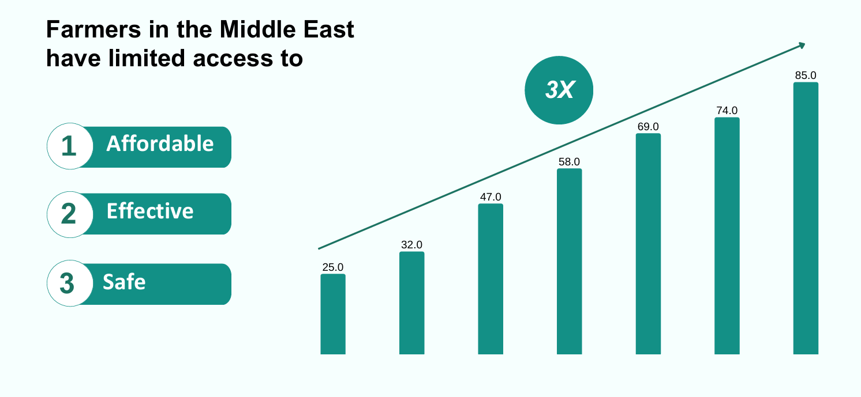

Slide 4
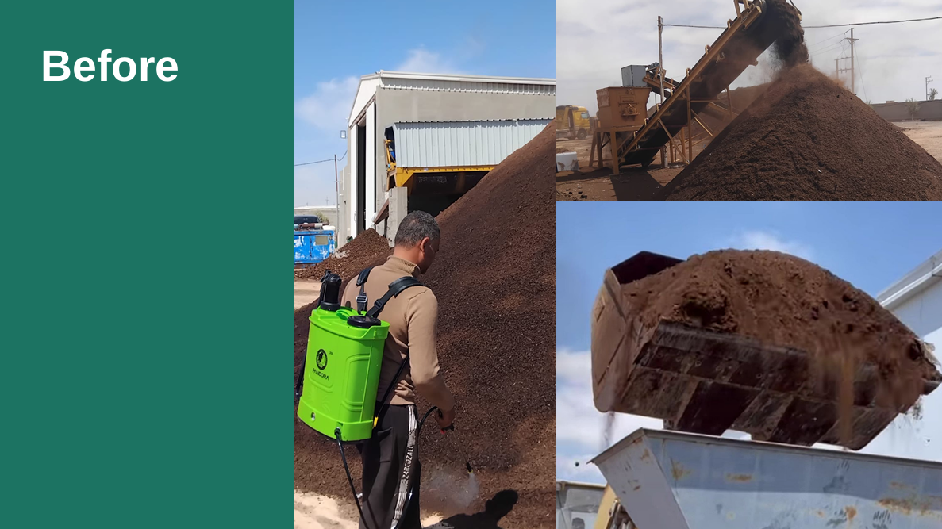

Slide 5
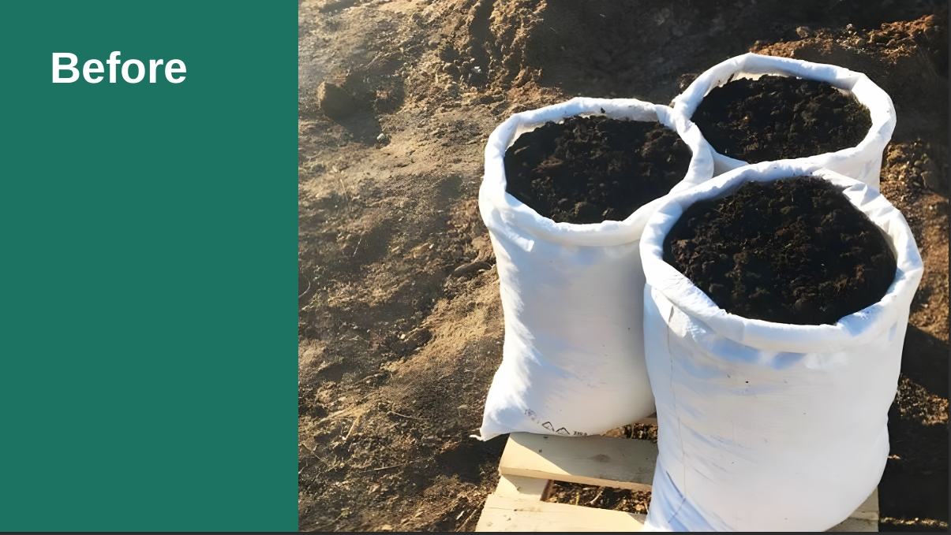

Slide 6
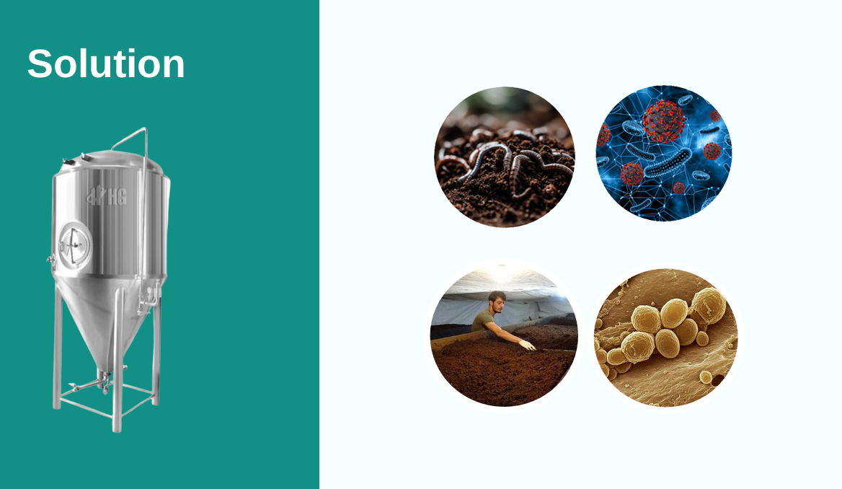

Slide 7


Slide 8

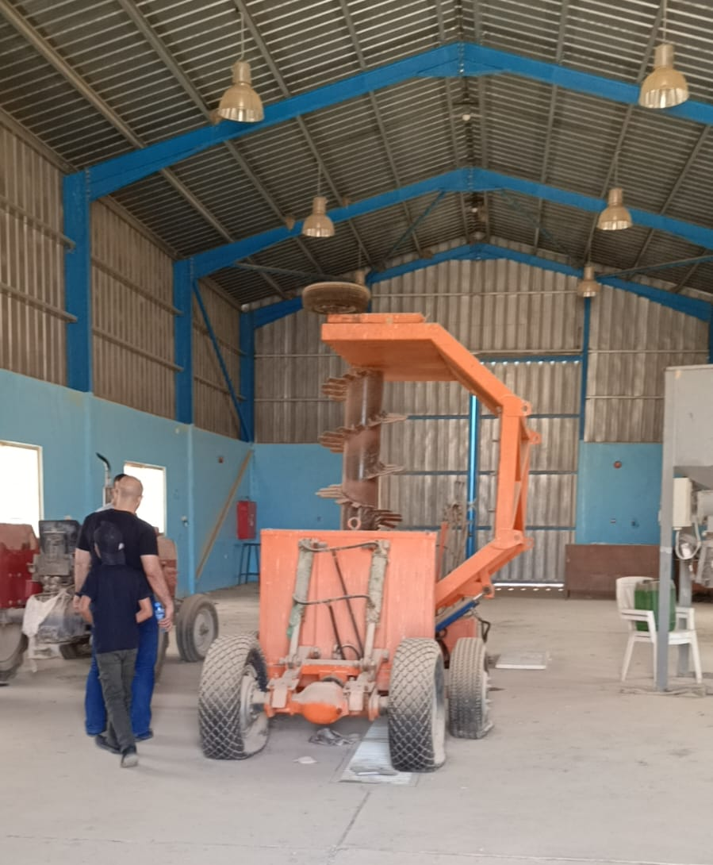
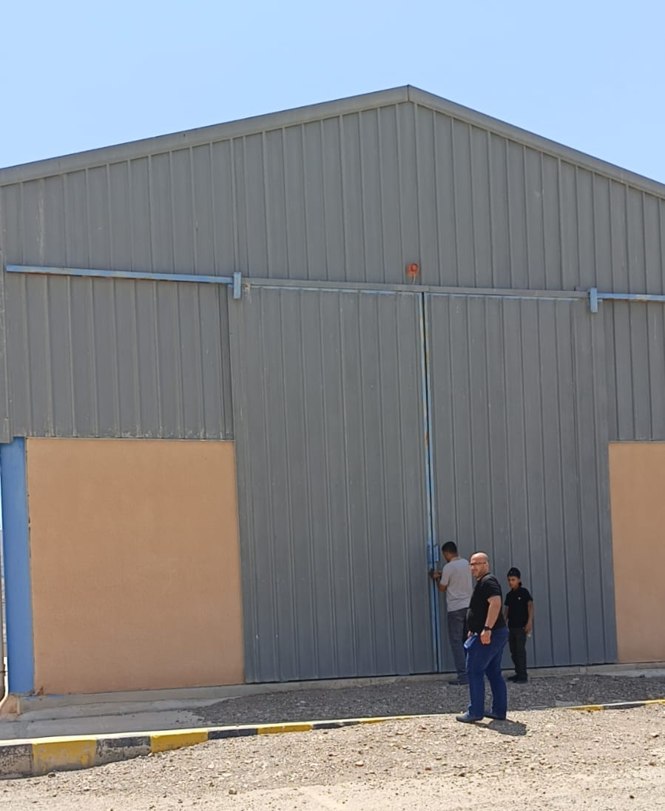
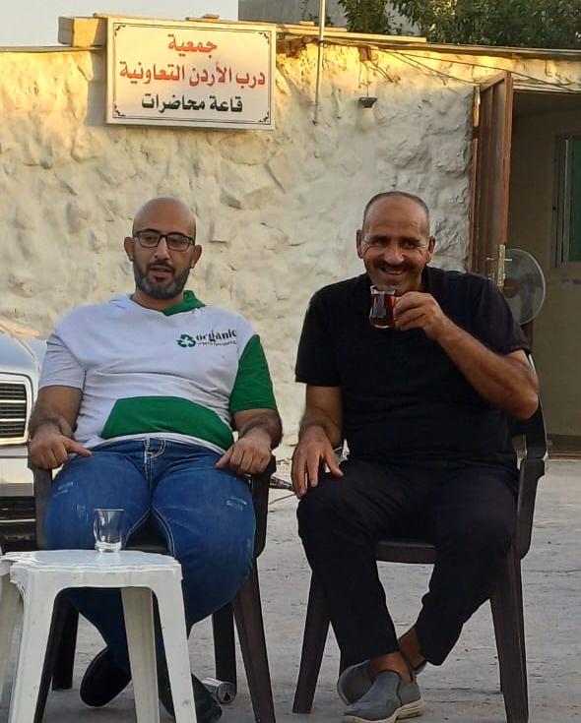

How …?
Expanding
Collaboration
Change Maker
Partnership

Slide 9
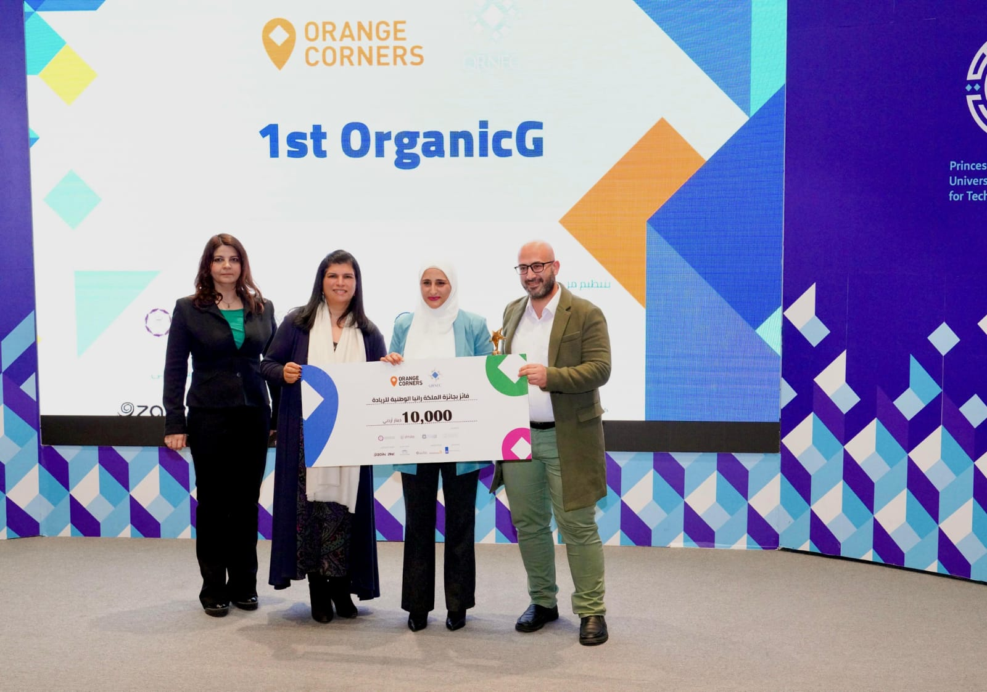
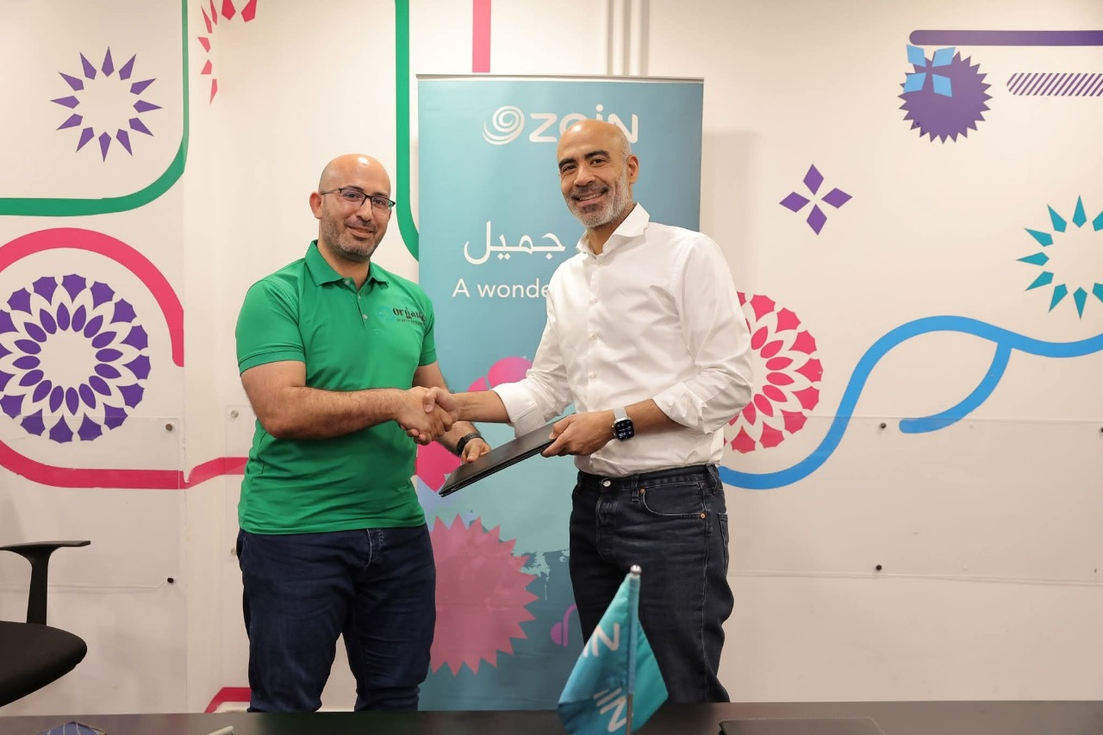
Key Achievements

Slide 10
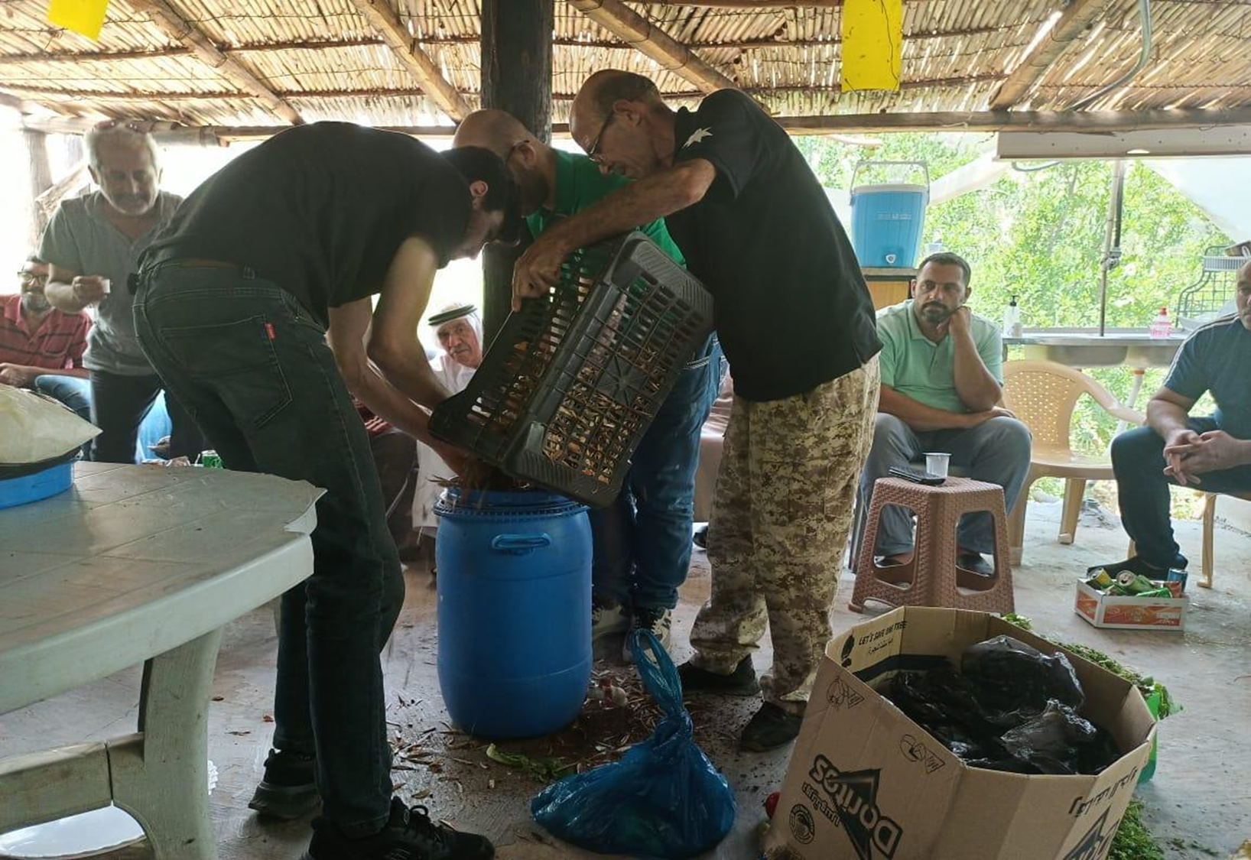
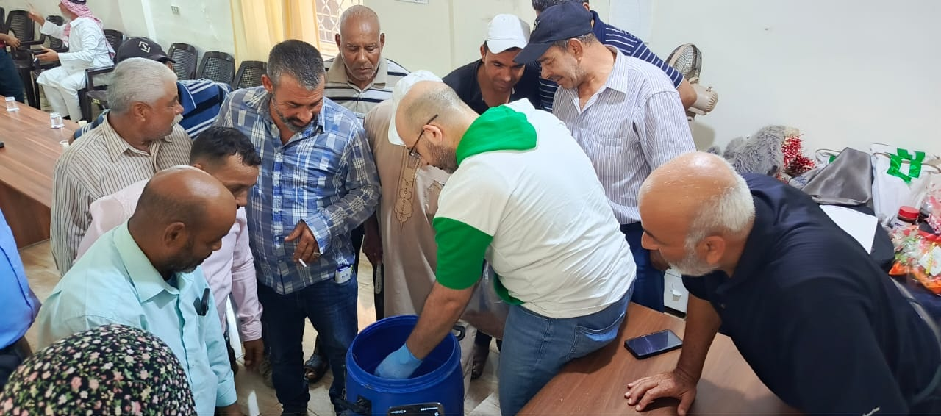
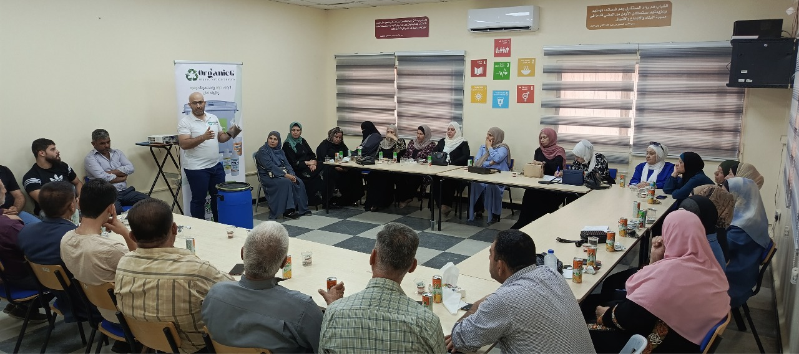

Slide 11

Helping farmers grow more while spending less

