Slide 1

البحث العلمي لتعزيز الاستدامة
قصص نجاح زراعية في الاستدامة
ايمن صبحا

Slide 2
Personal Information
Name:
Ayman Abd Elkarim Abdo Sabha
Date/Place of Birth: April 21, 1967 / Amman
Nationality: Jordanian
Social Status: Married
Profession: Agricultural Engineer
Address:
P.O.Box 823, Amman, Jordan

Slide 3
Education
My M.Sc. research was on “ Fruit abortion and productivity in four parthenocarpy cucumber hybrids under plastic house conditions in the Jordan Valley.”
- 1990 M.Sc. Plant Production Department, Faculty of Agriculture, University of Jordan, Amman, Jordan.
- 1988 B.Sc. Plant Production Department, Faculty of Agriculture, The University of Jordan, Amman – Jordan.
- 1984 General Secondary Education Certificate Examination.Shukri Sha’sha’ school, Amman – Jordan.

Slide 4
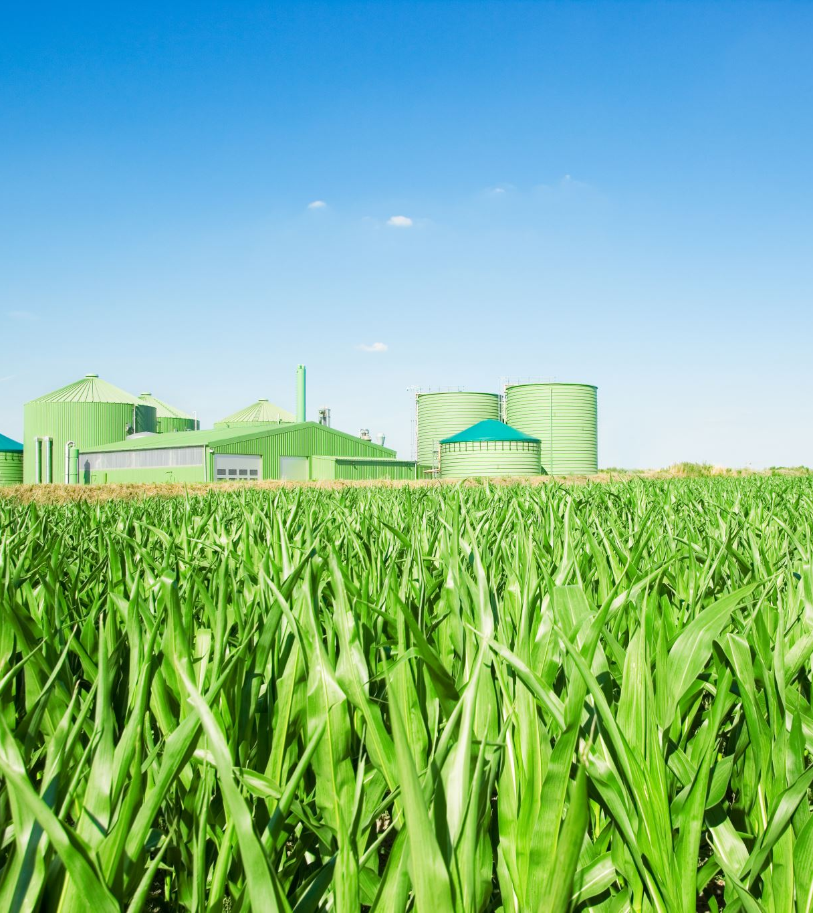
Practical Experience & Qualifications
Pioneer Project: Practical training in private and government farms in the middle Ghour region, under the supervision of the University of Jordan, from Sept.1987 – Jan.1988.
Internship: Practical training at the experimental farm of the Vegetable Crops Science Institute of Technical University of Munich in Weihenstephan, West Germany, during the Summer vacation of 1989.
Research Assistant (RA): from January 1988 – January 1989, for Prof.M.A. Suwwan on several research projects conducted in the field of Horticulture. The research focused mainly on the effect of growth regulators on the fruit set of several vegetables under plastic house conditions in the Jordan Valley.
Teaching Assistant (TA) : Teaching the practical part of the Vegetable Production course “61321”.

Slide 5
Practical Experience & Qualifications
Part-time working in Ghanam farm in the North Ghour for two years.
Working in the Jordanian Kuwait Company for Agriculture and Food Production in the field of marketing & selling compound liquid fertilizer (Hasad) from June 15,1991-Still.
Owner and the general manager for National Fairdose Co. for agricultural products, established in 1993.
Participating in new Ag contrivance in 2005 , 2006 , 2008 , 2009 , 2010, 2012 , and 2013 .
Participating in different conferences and exhibitions dealing with fertilizer in the field in the Alfrend countries.
Member of the administrative body of the Syndicate of Agricultural Materials Traders and Producers Association since September,2024

Slide 6
Company Profile
National Fairdose Company for Agricultural Products established in 1993 as a private shareholding company to market its products, and to operate two fertilizer experiment stations set in farms around Amman; one is set in Al-Shobak, south of Amman rented for ten years (1994-2004), which is considered an important production location for fruit trees, and the other is set in Al-Mafraq, north of Amman, a vegetable producing area, this station was rented for two years only, 1996 and 1997.
National Fairdose Company’s efforts extend to supplying farmers with fertilizers through an outlet owned by the company in the Jordan Valley.

Slide 7
Company’s Objectives
Our objective is to serve markets around the world that would benefit from our special chemical fertilizer product lines in any competitive environment.
National Fairdose provides the market with the high-quality agricultural products.

Slide 8


The distribution lines (Seeds)
We are the distributor for the following companies:
Alfalfa imported from S&W Company in the USA.
Corn Seed for Silage imported from Misr Hytech Seed Company in Egypt.

Slide 9
The distribution lines (Fertilizers)
Specialty Fluid Fertilizers
Clear Liquid Fertilizer
Specialty Solid Fertilizers
Water-Soluble Fertilizer
High Purity Acids
Phosphoric Acid
Suspension Fertilizer
Emulsion Fertilizer
Granular Dry Blend Fertilizer
Powder Slow-Release Fertilizer
Nitric Acid
Sulfuric Acid
Humic Acid
Trace Elements
Iron
Zinc
Manganese
Others
Single Fertilizers
Potassium
Magnesium Sulphate
Calcium Nitrate
Zinc Sulphate
Copper Sulphate
Manganese Sulphate

Slide 10
The distribution lines (Products from other sources)
Pesticides
Organic Fertilizer
Tubers.
Some of the above-mentioned products are supplied to farmers who are dealing with one source for all their farms’ needs as a favor by National Fairdose.

Slide 11
Looking Ahead
National Fairdose is continuously working on acquiring agencies to represent international seeds, fertilizer and pesticide producers in the Jordanian market and so always providing the market with only the highest quality products.
Contact Us
General Manager: Ayman Sabha
Email: sabhaa@nfcagri.com
Tel: +962 6 4124244
Fax: +962 6 4124245
Mobile : +962 777555909 +962795559091

Slide 12

National Ammonia and Chemical Industries
Founded: 1992 by 14 investors
Industry: Agri-chemicals and specialty fertilizers
Milestone: In 1997, multinational fertilizer corporation SCPA acquired 25% of shares
Strategic Value: Partnership strengthened production and market reach
Location: Amman, Jordan
Objective: A leading Jordanian manufacturer of agri-chemicals, National Ammonia and Chemical Industries, combines local expertise with international collaboration to deliver high-quality specialty fertilizers.

Slide 13
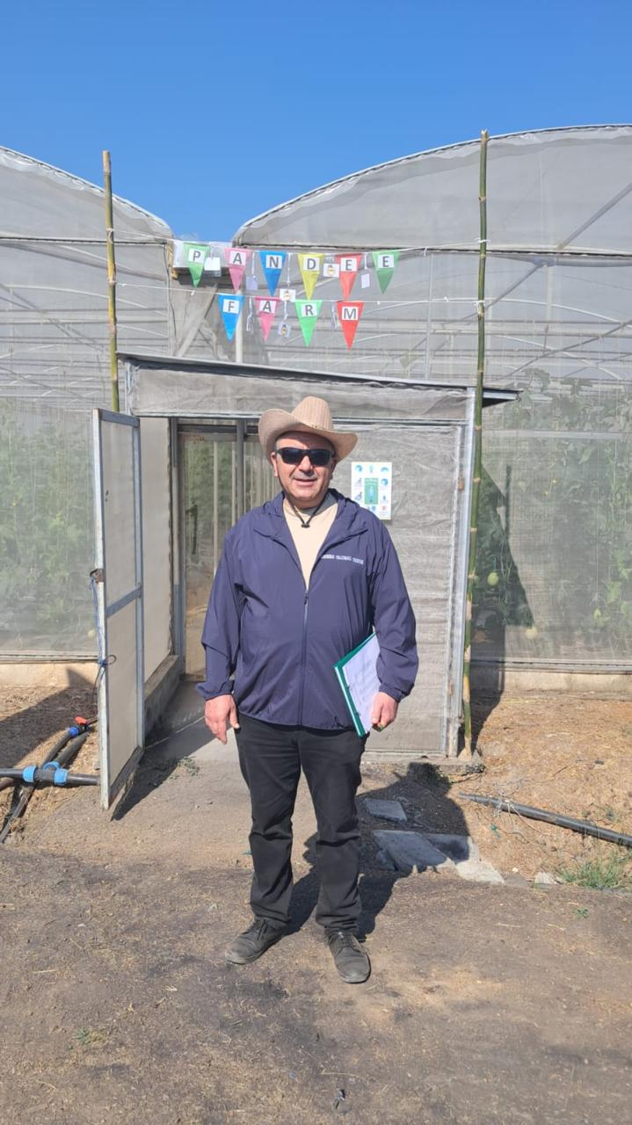
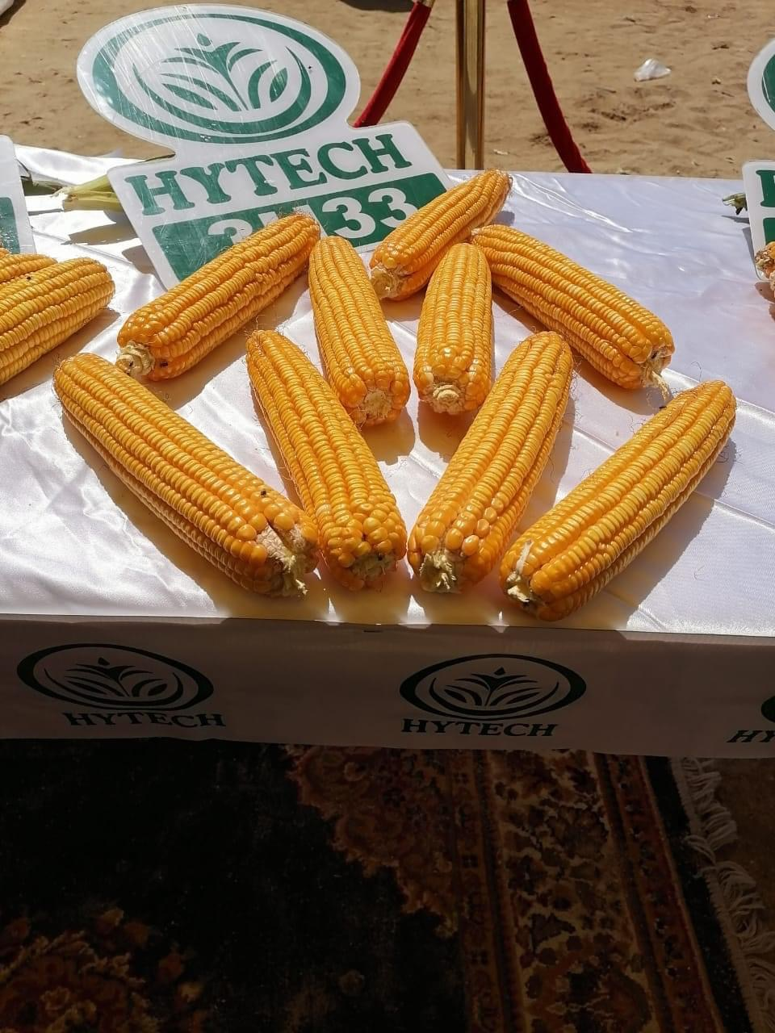
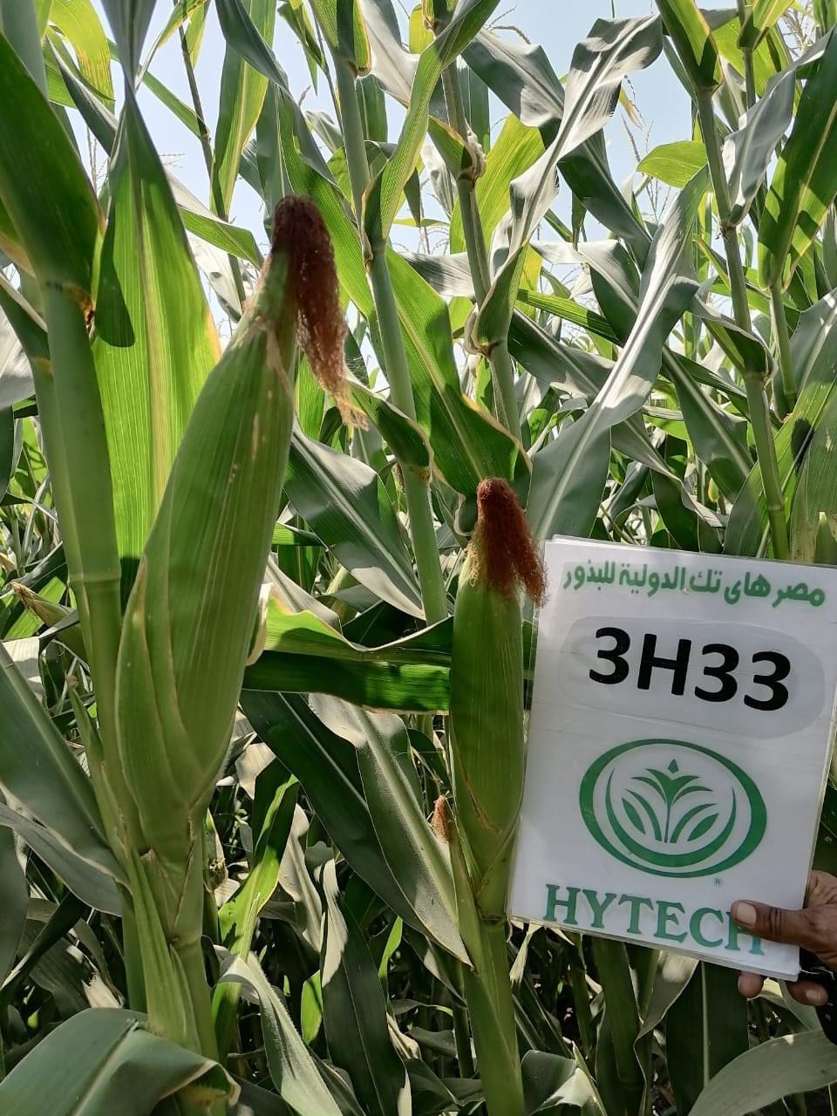
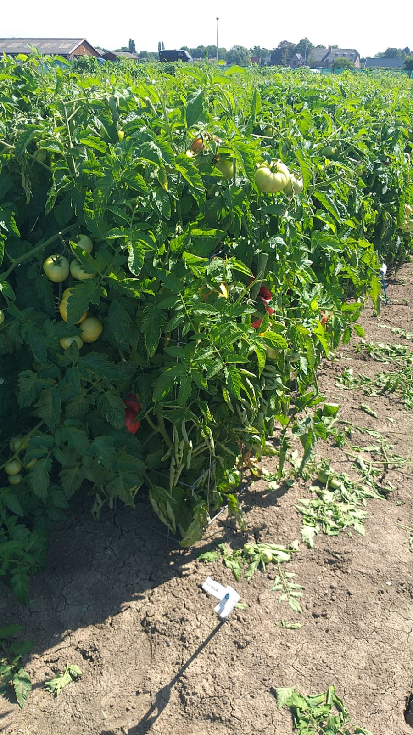
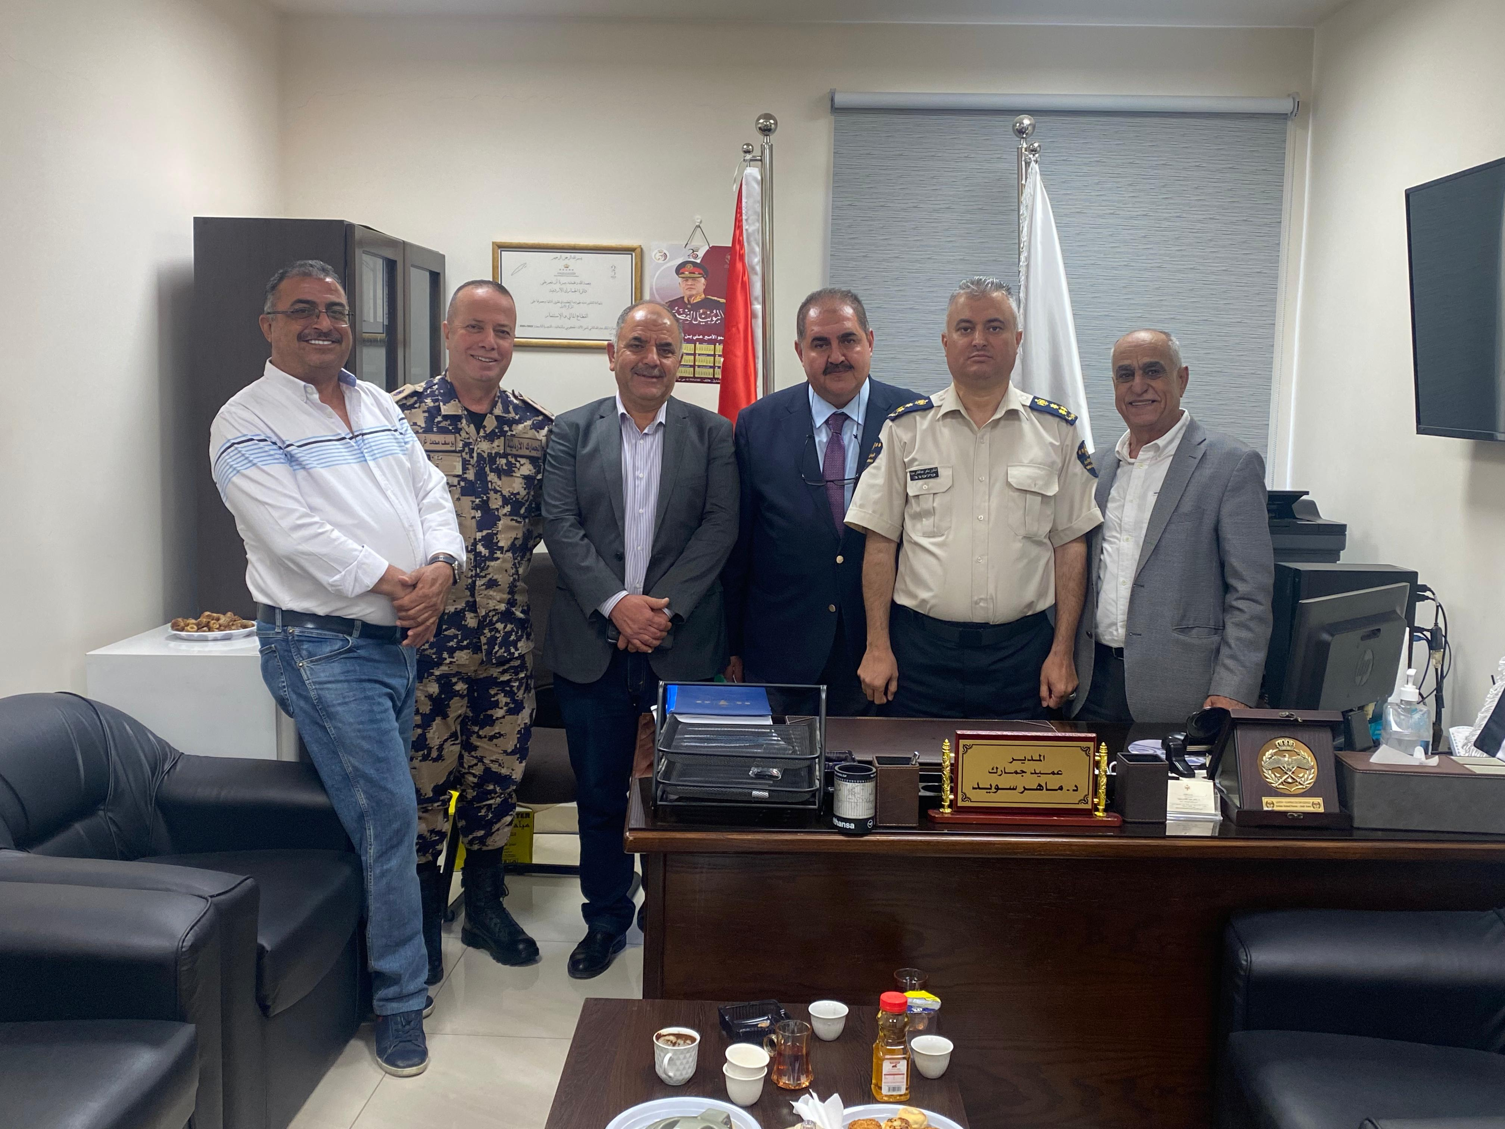
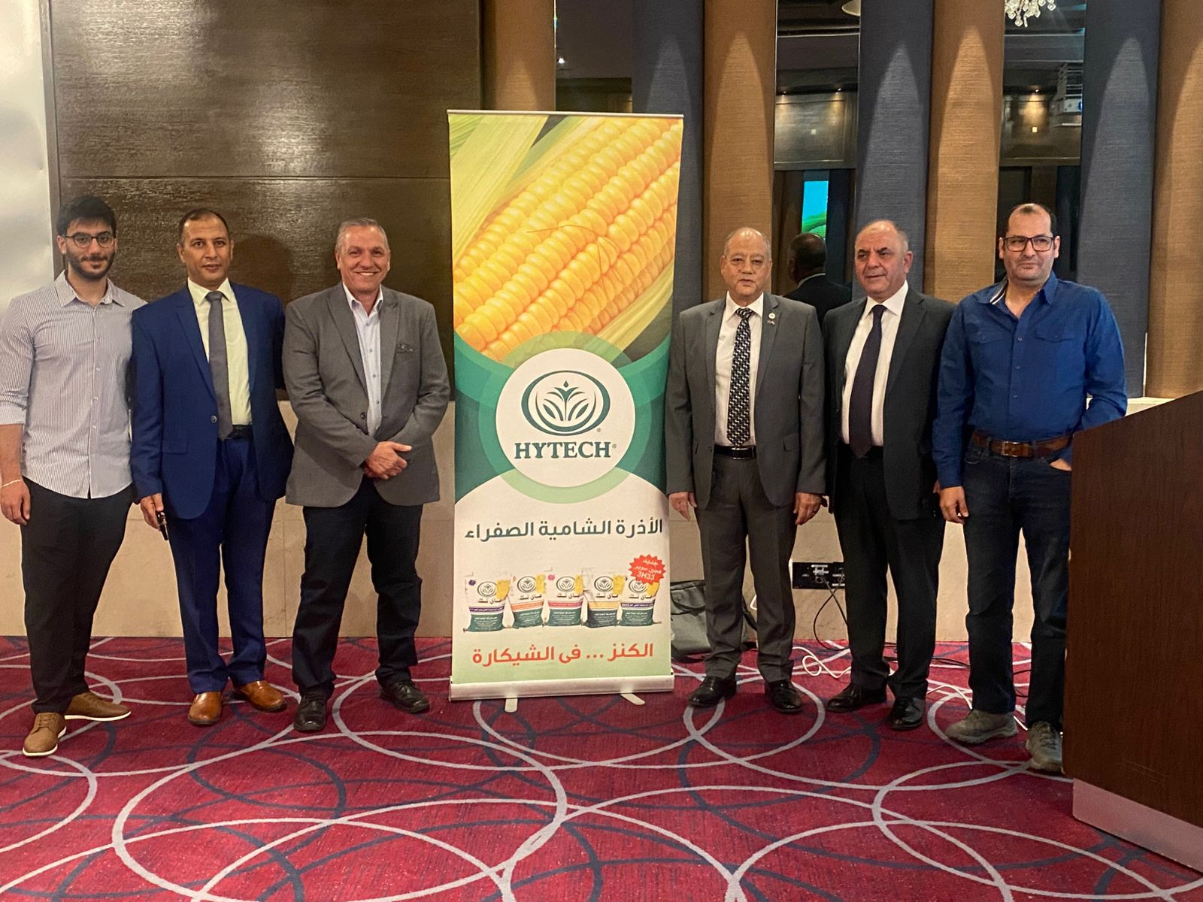

Slide 14
