Slide 1

Innovation in agriculture & sustainability
Transforming Jordan's Agricultural Future

Slide 2





The Agriculture Revolution
Agricultural technology market expected to exceed $3 billion by 2025
Global food production must increase by 60% by 2050 to feed 9.3 billion people
The Global Context
41% of farmers cite weather and climate change as their top concern (2024)
Traditional farming methods strain natural resources and ecosystems
Notes:
https://www.fao.org/fsnforum/resources/reports-and-briefs/future-food-and-agriculture-trends-and-challenges
https://www.un.org/development/desa/pd/sites/www.un.org.development.desa.pd/files/wpp2022_summary_of_results.pdf
https://agtechbreakthrough.com/agtech-2025-key-trends-innovations-and-challenges-shaping-the-future/

Slide 3

Jordan's Unique Position
About 5% of employment
61% of crops self-sufficiency
Agriculture contributes about 6.9 % of GDP 2024
More than 2 Billion JOD Sector investment
Second water-poorest country in the world
Notes:
https://www.worldbank.org/en/news/feature/2023/11/30/new-crop-of-climate-smart-farmers-in-jordan-will-feed-future-generations#:~:text=Around%20a%20quarter%20of%20Jordan's,20%E2%80%9325%20percent%20of%20GDP.

Slide 4
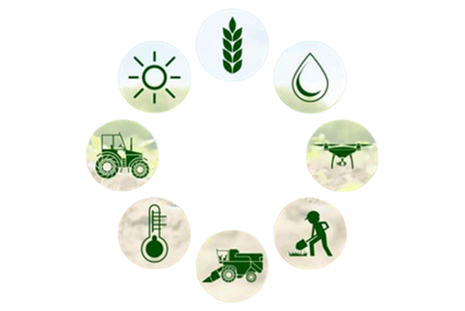
Agricultural Innovation

Slide 5
Core Challenges & Agricultural Innovation
Soil
Water
Climate
Seeds & Crop Varieties
Agriculture Pest

Slide 6

1- Soil
Pain:
Poor soil structure reduces water retention, causing drought stress.
Weak soil aeration limits root growth.
Low nutrients in degraded soils reduce crop yield and quality.
Gain:
Use Eco-friendly soil fabrics or covers.
Organic aggregates and compost.
Applying precision agriculture using soil mapping and data analysis.

Slide 7

2- Water
Pain:
Limited water availability reduced yields.
Poor water quality can harm plants and soil health.
Lack of smart irrigation solutions limits productivity.
Gain:
Drip irrigation.
Soil moisture sensors and monitoring systems.
Hydroponics and aeroponics systems.

Slide 8

3- Climate
Pain:
Unpredictable climate causes crop stress and reduces yields.
Erratic rainfall and temperature disrupt growing cycles.
Water scarcity from climate shifts limits irrigation.
Gain:
Using locally adapted crop varieties resistant.
Rainwater harvesting and water storage systems.
Adoption of climate-smart agriculture (CSA).

Slide 9
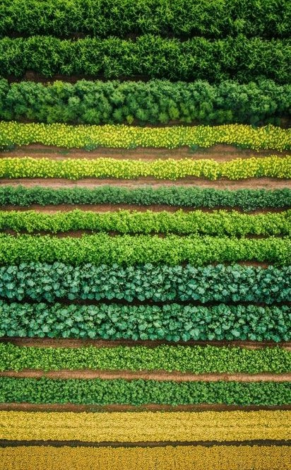
4- Seeds & Crop Varieties
Pain:
Poor seed or crop variety selection reduces crop quality.
Low climate-resilient varieties increase risk from extreme weather.
Lack of innovative seeds limits adaptation to harsh environments.
Gain:
Genetic breeding produces stronger, higher-yield, resilient crops.
Pest-resistant seeds reduce chemical use and improve crop health.
Sustainable seeds save water and adapt to local conditions.

Slide 10
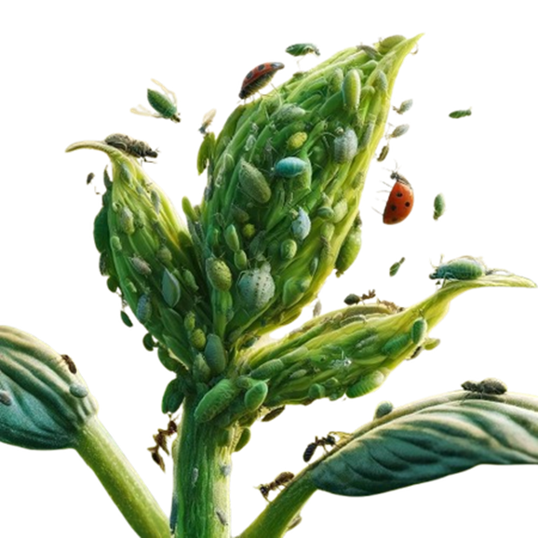
5- Agricultural Pest
Pain:
Pests and diseases cause crop damage and lower yields.
Ineffective pest management leads to higher economic losses.
Overreliance on chemicals harms the environment and soil health.
Gain:
Early detection and monitoring with sensors and drones.
Digital documentation and traceability optimize pesticide use.
Targeted biological control and AI tools improve pest management.

Slide 11

Innovative Agriculture Models:
Hydroponics
Aeroponics
Controlled
Environment
Agriculture
Aquaponics
Indoor Farming

Slide 12
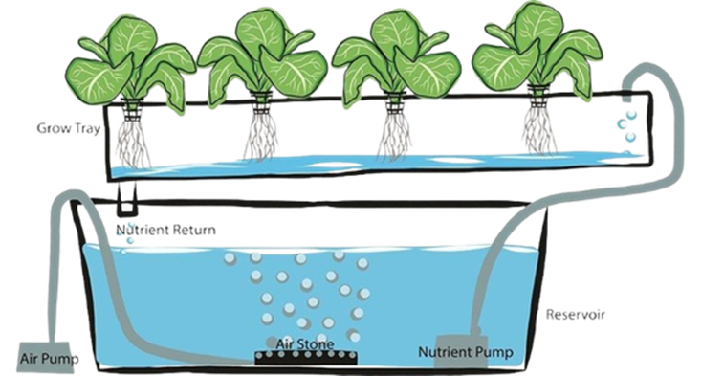
1- Hydroponics:
Soil-free farming using water-based nutrient solutions.
90% less water than traditional farming.
Faster growth cycles and higher yields.

Slide 13
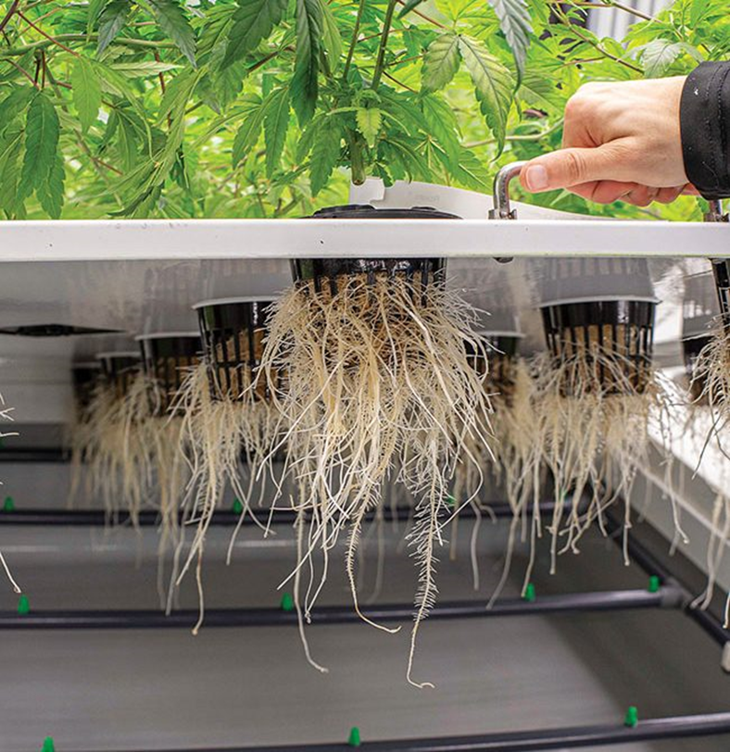
2- Aeroponics:
Plant roots suspended in air, misted with nutrient solution.
Maximum oxygen exposure for optimal growth.
Minimal water and space requirements.

Slide 14
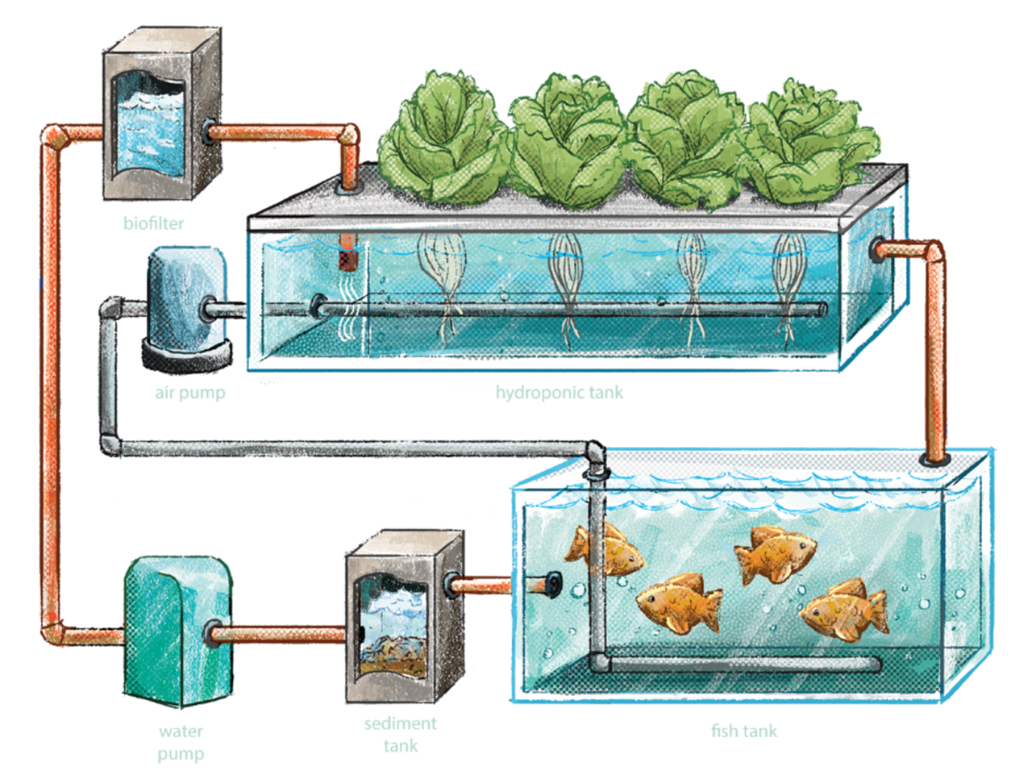
3- Aquaponics:
Integration of fish farming with plant cultivation.
Fish waste provides organic nutrients for plants.
Closed-loop sustainable system.

Slide 15
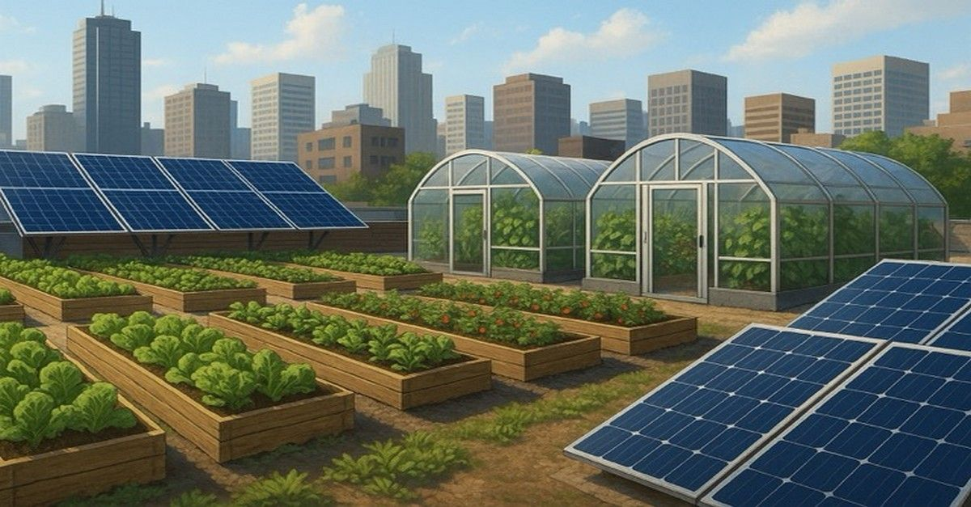
4- Indoor Farming:
Indoor farming is growing crops inside cities using spaces such as rooftops, vacant lots, and unused buildings to produce fresh local food. Using LED lighting, climate control, and smart sensors to optimize plant growth.
Benefits:
Reduces transportation and carbon emissions.
Utilizes unused spaces efficiently.
Improves food security in cities.
Notes:
https://viemose-dgs.dk/indoor-farming/

Slide 16
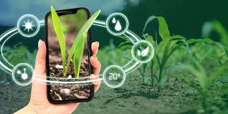
Agricultural innovation technologies

Slide 17
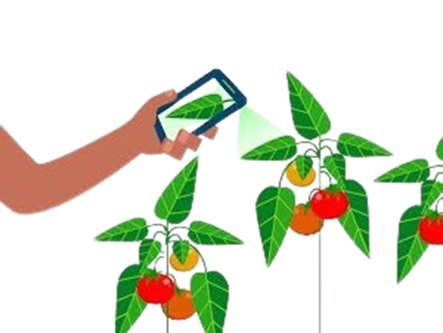
1. AI-Based Agricultural Pest Diagnosis:
Technology: Deep learning, Convolutional Neural Networks (CNNs).
Impact: Real-time detection of diseases; reduces crop loss; faster treatment.
Example: Mobile apps and AI platforms that scan leaves to identify pests/diseases instantly.

Slide 18
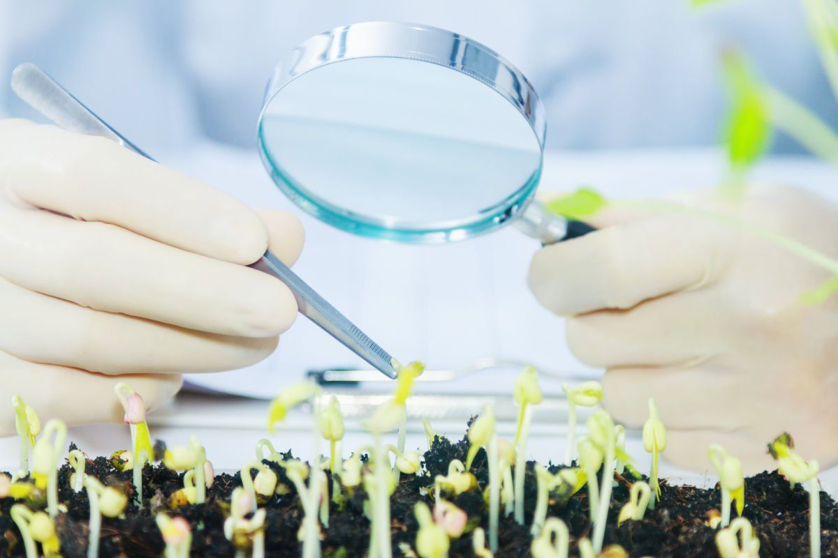
2. Biotechnology & Improved Seeds:
Technology: CRISPR, genetically modified crops.
Impact: Drought-resistant, pest-resistant, higher-yield crops.
Example: Rice varieties resistant to flood or salinity.

Slide 19
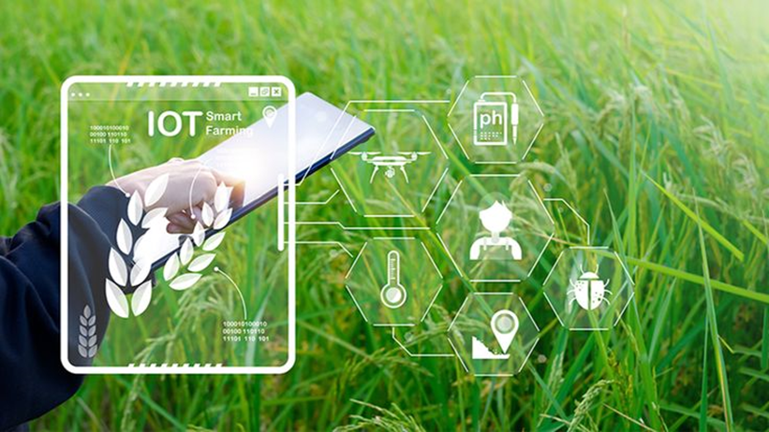
3. IoT Sensors in Agriculture:
• Technology: IOT sensors monitor soil moisture, temperature, and humidity in real time.
• Impact: Better irrigation management and higher crop productivity.
• Example: Soil moisture sensors that automatically activate irrigation when the soil becomes dry.

Slide 20
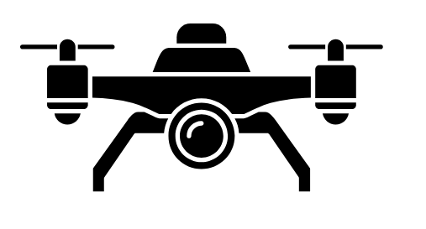
4. Satellite Imagery & Drones
Monitor crop health through NDVI (Normalized Difference Vegetation Index).
Detect disease and nutrient deficiencies early.
Precision mapping for targeted interventions.

Slide 21

Agricultural Innovation: A Sustainable Perspective
Key Benefits:
Efficient resource use: Saves water, energy, and soil nutrients.
Environmental protection: Reduces chemical use and greenhouse gas emissions.
Improved yields: Boosts crop quality and production sustainably.
Key Point: Sustainable agricultural innovation balances productivity, resource efficiency, and environmental protection.

Slide 22
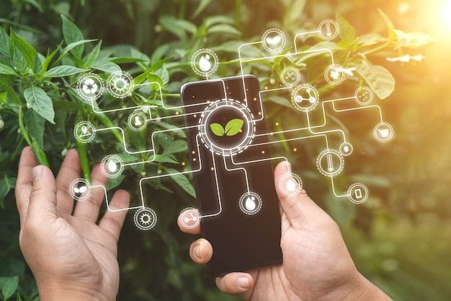
Agricultural innovation is not just about technology—it is about transforming the entire agricultural ecosystem. By improving productivity, sustainability, and resilience, innovation plays a crucial role in ensuring food security and supporting sustainable economic development worldwide.

Slide 23

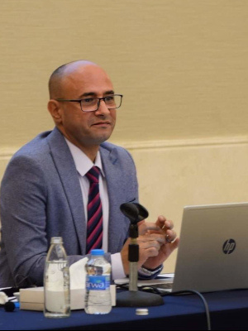



JAIP Founder
Dr. Khaled Khraisat
Founder and CEO
+962 79 5543993
khaled@thejaip.com

Slide 24

THANK YOU

